Slide 1

🌍 Disaster Impact and Response Analysis in Africa 2005 - 2019
By: IHEJIETO, ANITA CHISOM
May 31, 2025
Aims Info Data Analysis project

Slide 2

Table of contents
Executive summary
Key findings
Dataset Overview
Data cleaning and transformation
Exploratory data analysis
Recommendation
Conclusion
Call to Action

Slide 3

Executive summary
Disasters continue to have a profound impact on African development and human well-being. In the past years, the world has experienced a series of epidemic and disease outbreaks, significantly impacting global health systems, economies, and communities. This report analyzes epidemic and disease outbreak events across African countries using data from the EM-DAT database. The aim is to;
uncover trends and patterns in disease occurrence, severity, Impact and geographic spread.
Identify the most frequent epidemic subtypes, affected sub-regions and countries.
Evaluate the distribution of international support such as Appeals, Declarations, and OFDA/BHA responses.
Detect impact and Outliers in durations and number of deaths tolls.

Slide 4

Key findings
Epidemic outbreaks, especially bacterial and viral diseases, are frequent across many African countries.
Western, Eastern and Middle Africa are among the most affected UN Sub-regions.
Cholera and Meningococcal diseases are the most occurred disease across the African Countries
2005-2006 had the highest spike in Epidemic disasters and it depreciated over time
With Africa being amongst the less developed countries, there was little or no Declarations, Appeals and International responses across the UN Sub-Regions.

Slide 5

Dataset overview
Source: Emergency Event database (EMDAT)
Focus: Epidemics in African countries (2005–2019)
Key fields: Disaster Subtype, Event, Country, Start and End dates, Duration days, Total Deaths.

Slide 6
Data cleaning and transformation
Import necessary libraries for cleaning (Pandas, numpy) and for visualization (matplotlib.pyplot, seaborn)
Load and read the excel file
Removed duplicates
Remove extra spaces between column strings
Dropped columns with >50% null values
Dropping multiple columns that couldn't be removed because their headers included special characters within like , '' 0987,$
Converted date fields into appropriate data type
Calculated a new field Disaster durations
Merge ISO dataset to extract UN Sub-regions and development regions

Slide 7

Exploratory Data Analysis
Let’s dive in

Slide 8
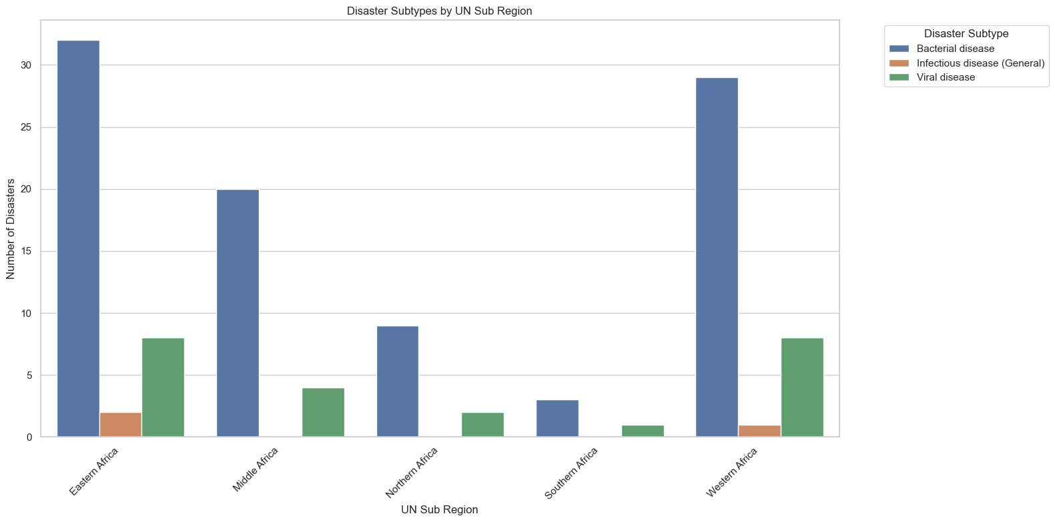
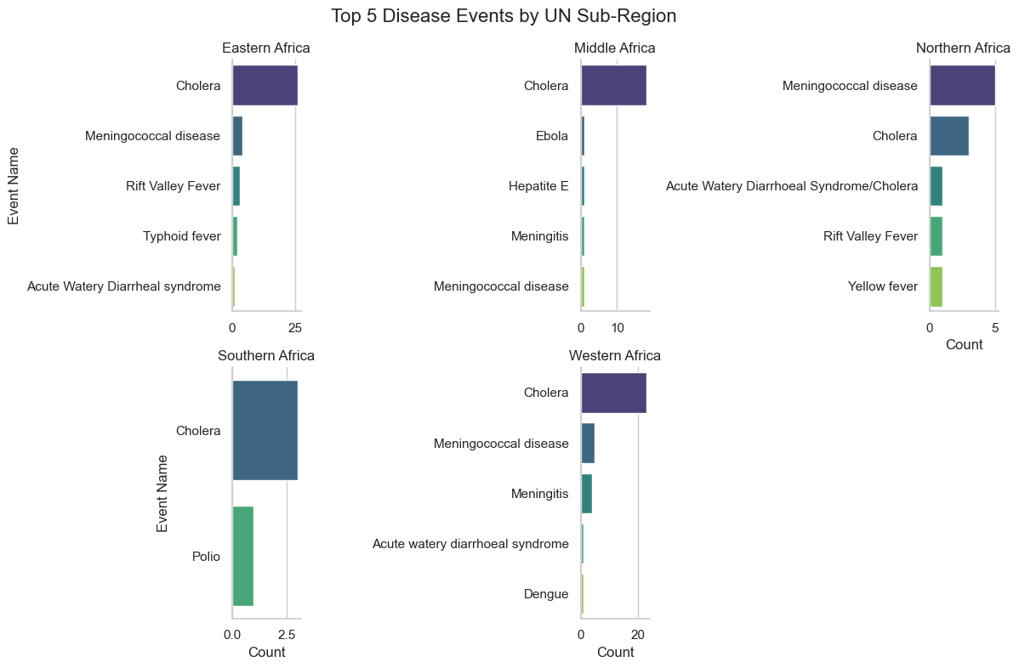
Disaster subtype by UN Sub-region
Epidemic types vary across sub-regions, Cholera and Meningococcal diseases are the most frequently occurring epidemic subtypes, while meningitis are common in the West/Middle Africa. Southern Africa is the least affected Region with only two diseases (Cholera and Polio).

Slide 9
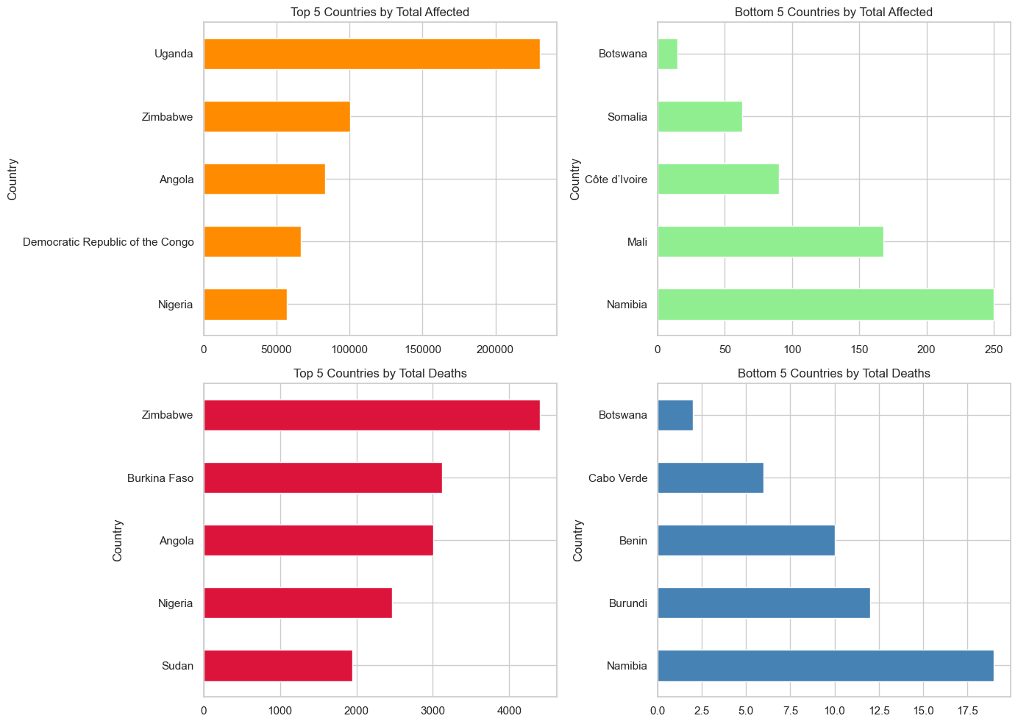
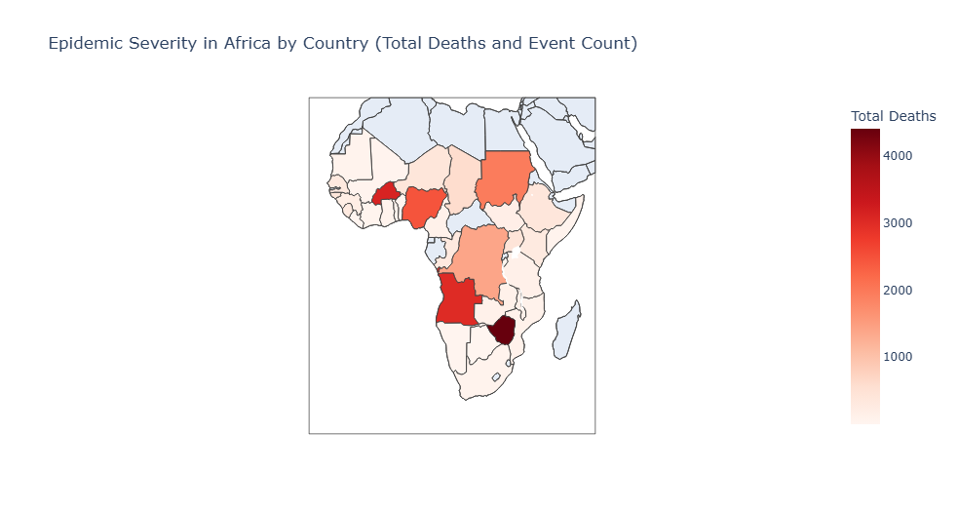
Top and Bottom 5 Affected/Death Rate across countries
From this visuals, the countries that had high death rate are Burkina Faso, Nigeria from the West, Sudan from the north, Zimbabwe from the East being the, Angola and Democratic Republic of Congo from Middle Africa. Least affected and least deaths are in more stable nations like Benin republic, Botswana etc

Slide 10
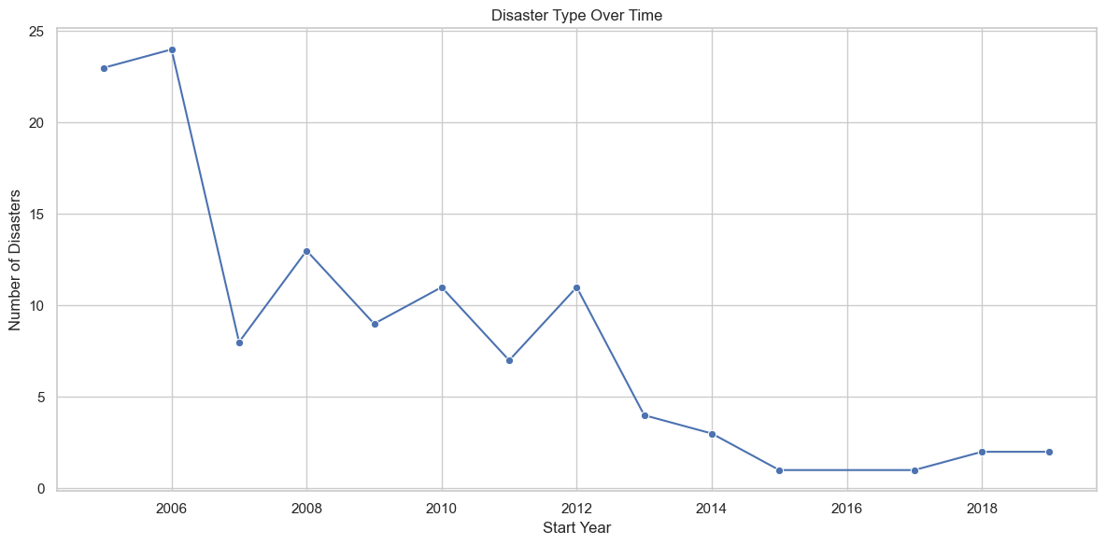
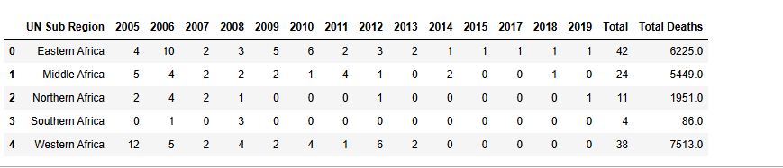

Disaster Events and death over time
Epidemic events increased with visible peaks between 2005 to 2006.
Later years (2007-2019) shows decline.
Even though 2005 had high events disease occurrence, the number of death was still not as significant as 2006 and 2008.
Long number of events or duration doesn’t guarantee high fatality.

Slide 11
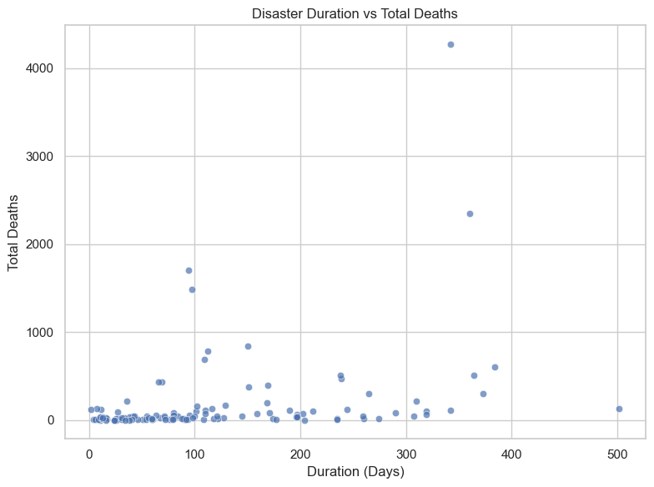
International response across UN Sub regions
Majority of epidemic events are of short duration and result in low fatalities. Some Short Epidemics Were Extremely Deadly. One or two points show very high death tolls (above 2,000) under 300-400 days long. These could represent cholera, Meningococcal diseases outbreaks known for rapid spread and high mortality even in short periods. Events lasting over 200 days (even up to 500) mostly stay under 1,000 deaths, suggesting again that long duration doesn’t guarantee high fatality.

Slide 12
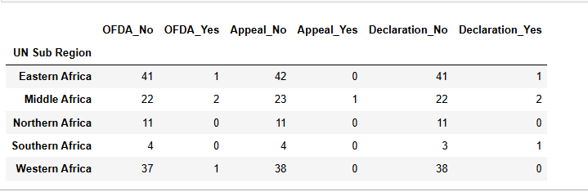
International response across UN Sub regions
The sub-regions had little or No declarations, appeals or even International US humanitarian Aids, and. Africa's sub-regions most likely received little or no declarations, appeals, or US humanitarian aid during epidemics even though Africa is amongst the less developed Regions, this could be due to various.

Slide 13

Recommendation
Government should prioritize regional early-warning systems and tailor region specific policies.
They should also tailor public health policies and build resilient healthcare systems across the African continent and also focus on early detection and rapid response.
Government can Strengthen water safety programs, vector control and public sanitation and hygiene, routine immunization and Vaccination.
Humanitarian organizations can Invest and prioritize stockpiling vaccines and treatments.

Slide 14

Conclusion
Bacterial and viral diseases, are the most frequently reported disasters.
While duration plays a role in the impact of an epidemic, it is not the primary predictor of death toll.
Short but deadly outbreaks emphasize the need for rapid response and containment, while longer, less fatal outbreaks highlight the importance of sustained public health infrastructure and prevention.
Epidemic threats are regional and often recurring.

Slide 15
Short Epidemics, Deep Scars 🌍 “The deadliest outbreaks weren’t always the longest, they were the fastest and the most unprepared for”. Epidemics don’t wait, Neither should we.
WHAT QUESTIONS DO YOU HAVE?
anitaihejieto@gmail.com

